Slide 1
Bellabeat Case Study
Presenter: Apurva Yadav
Last Updated: 30-03-2022

Slide 2
Agenda
Introduction
Project overview and goals
Data and Analysis
Recommendations
Questions

Slide 3
Business Task
Analyze smart device usage data in order to gain insight into how consumers use non-Bellabeat smart devices. This would help Bellabeat’s Marketing team to influence their marketing strategy.

Slide 4
Data Sources
FitBit Fitness Tracker Data – Kaggle
This dataset was generated by respondents to a distributed survey via Amazon Mechanical Turk between 12th March 2016 to 12th May 2016.
Thirty eligible Fitbit users consented to the submission of personal tracker data, including minute-level output for
physical activity
heart rate
sleep monitoring

Slide 5
Visualizations To make things clear!

Slide 6
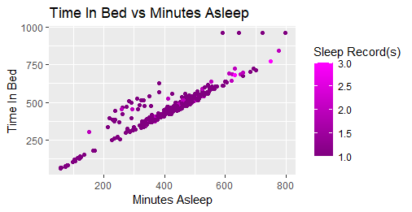
Instead of getting a linear relationship, A somewhat dispersed relationship appears. This means that more time in bed doesn’t necessarily represent more sleep.
Notes:
Instead of getting a linear relationship we got a somewhat dispersed relationship. This means that more time in bed doesn’t necessarily represent more sleep.

Slide 7
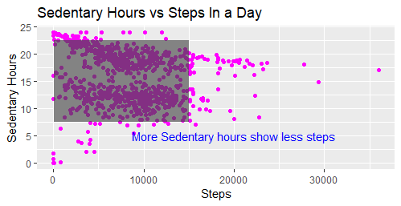
More sedentary hours show fewer steps. This can be used to market the product. This could mean that people who sit more tend to walk less.
Notes:
More sedentary hours show fewer steps. This can be used to market the product. This could mean that people who sit more tend to walk less.

Slide 8
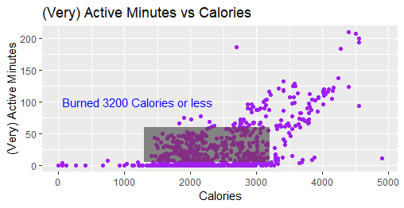
People who have Very active minutes less than 60 have burned 3200 calories or less while people with very active minutes greater than 60 have burned more calories.
Notes:
From the visualization, we can see that people who have Very active minutes less than 60 have burned 3200 calories or less while people with very active minutes greater than 60 have burned more calories

Slide 9
Analysis Insights
More sedentary hours show fewer steps.
People who have Very active minutes less than 60 have burned 3200 calories or less while people with Very active minutes greater than 60 have burned more calories.
More time in bed doesn’t necessarily represent more sleep.

Slide 10
Recommendation(s)
Bellabeat device with Calorie meter, Sleep monitor, and step counter should be marketed. These features are a must for a smart fitness device.

Slide 11
Thank You. Any questions are welcome!

